Slide 1
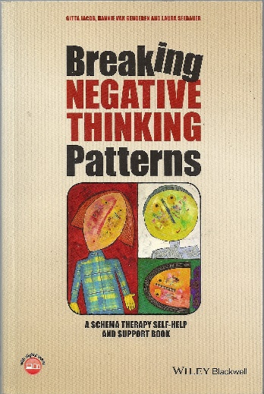
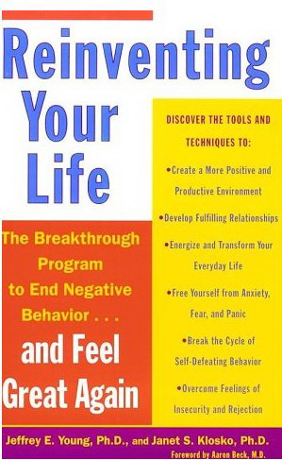
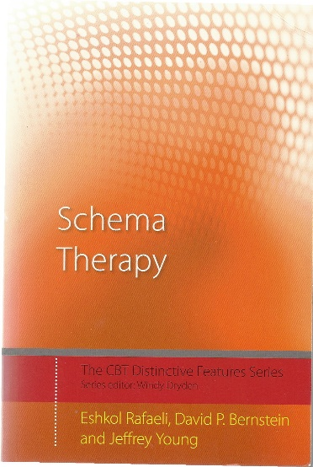
A SELECTION OF BOOKS ON SCHEMA THERAPY David Edwards May 2015
Jacob, Gitta, van Genderen, Hannie., & Seebauer, Laura. (2015). Breaking negative thinking patterns. Chichester: Wiley-Blackwell.
A bibliotherapy resource for clients. Provides a very clear introduction to the schema therapy approach and shows how the basic concepts relate to client’s everyday experience. There is a very clear explanation of the mode model and many useful practical exercises.
See it at: http://www.amazon.co.uk/Breaking-Negative-Thinking-Patterns-Self-Help/dp/1118877713
Young, J. E. & Klosko, J. (1994). Reinventing your life. New York: Plume
The classic bibliotherapy for clients. It focuses on several of the prominent EMSs and shows how coping patterns create “Lifetraps” and how schema therapy helps to overcome them
See it at: http://www.amazon.co.uk/Reinventing-Your-Life-Breakthrough-Behaviour/dp/0452272041
Rafaeli, E., Bernstein, D. P. & Young, J. (2011) Schema Therapy (The CBT Distinctive features series). London: Routledge.
A brief well organized introduction that covers all the important concepts.
See it at:
http://www.amazon.co.uk/Schema-Therapy-CBT-Distinctive-Features/dp/0415462991/

Slide 2
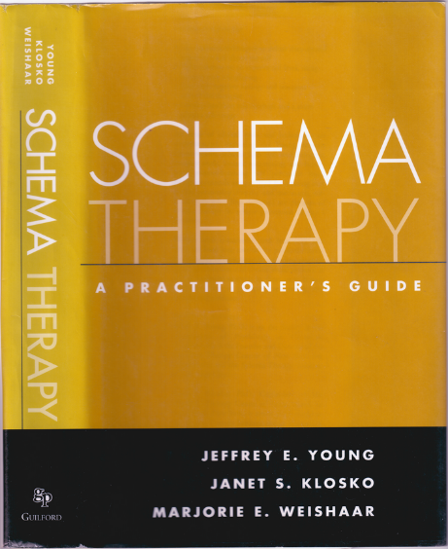
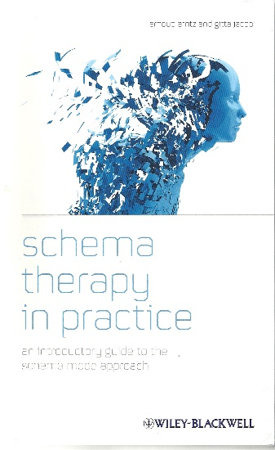
Books on schema therapy page 2
Young, J. E., Klosko, J., & Weishaar, M. E. (2003). Schema therapy: A practitioner's guide. New York: Guilford.
A comprehensive account of schema therapy and its development from Jeff Young and colleagues. It provides the theoretical foundation for schema therapy as well as how to do it in practice. Available in hardback or paperback.
See it at:
http://www.amazon.co.uk/Schema-Therapy-Practitioners-Jeffrey-Young/dp/1593853726
Arntz, A. & Jacob, G. (2012). Schema Therapy in practice. Oxford: Wiley/Blackwell.
A practical guide to working with schemas and schema modes. Focuses on the schema mode model, within which cases can be more easily conceptualized and emotionally focused interventions more smoothly introduced. Includes examples from a range of personality disorders as well as anxiety, depression and OCD.
See it at:
http://www.amazon.co.uk/Schema-Therapy-Practice-Introductory-Approach/dp/1119962862/

Slide 3
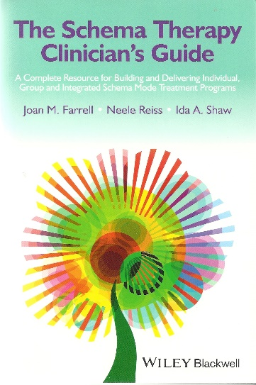
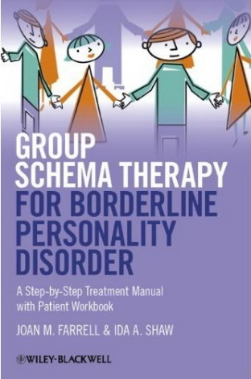
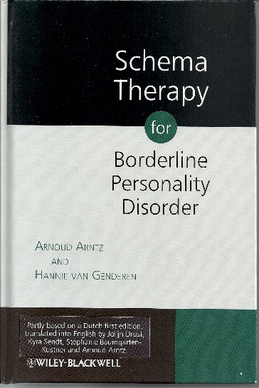
Books on schema therapy page 3
Farrell, J.M., Reis, N., & Shaw, J. (2014). The schema therapy clinician’s guide: A complete resource for building and delivering individual, group and integrated schema mode treatment programs. Chichester: Wiley-Blackwell.
Full of clinical examples that provide readers with a grounded and accessible sense of what schema therapy is all about and how to put it into practice. There is a clear structure and a wealth of resources for its implementation including worksheets and scripts for therapists to use at different stages or for different purposes.
See it at: http://www.amazon.co.uk/Schema-Therapy-Clinicians-Guide-Delivering/dp/111850917X
Farrell, J. M. & Shaw, I. A. (2012). Group schema therapy for borderline personality disorder: A step-by-step treatment manual with patient workbook. Chichester: Wiley.
Joan Farrell and Ida Shaw developed group schema therapy, a very distinctive form of group therapy for patients with borderline personality disorder. This manual provides guidelines on how to do it.
See it at: http://www.amazon.co.uk/Schema-Therapy-Borderline-Personality-Disorder/dp/1119958296
Arntz, A. & van Genderen, H. (2009). Schema Therapy for Borderline Personality Disorders. Oxford: Wiley/Blackwell.
Based on methods developed for the Dutch clinical trial of schema therapy, this book describes the basic concepts and many practical and useful techniques that can be incorporated into schema therapy.
See it at: http://www.amazon.co.uk/Schema-Therapy-Borderline-Personality-Disorders/dp/0470510803/

Slide 4
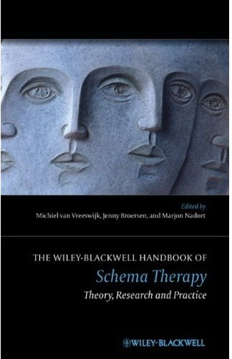
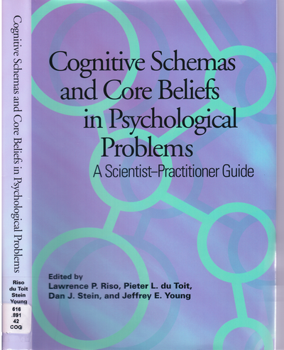
Books on schema therapy page 4
Over 600 pages and over 40 chapters covering the spectrum of theory and practice. There’s a chapter by myself and Arnoud Arntz on the history of schema therapy and chapters on a wide range of topics from case conceptualization to imagery and chairwork, to depression, eating disorders, OCD, and various personality disorders including narcissistic and antisocial. There are several chapters on incorporating mindfulness meditation, on group schema therapy schema therapy for couples and the current evidence base for the effectiveness of schema therapy. Expensive though!!
van Vreeswijk, M., Broersen, J. & Nadort, M. (2012).The Wiley-Blackwell handbook of schema therapy: Theory, research and practice. Chichester: Wiley.
See it at:
http://www.amazon.co.uk/Wiley-Blackwell-Handbook-Schema-Therapy-Research/dp/047097561X
Riso, L. P. du Toit, P. L., Stein, D. J. & Young J. E. (Eds.) (2007). Cognitive schemas and core beliefs in psychological problems: A scientist-practitioner guide (pp. 139-175). Washington DC: American Psychological Association.
A research resource, not exclusively on schema therapy. There are good chapters on schema based conceptualization for a range of clinical problems including depression, OCD, PTSD, substance abuse, eating disorders, psychosis and discord in couples
See it at:
http://www.amazon.co.uk/Cognitive-Schemas-Beliefs-Psychological-Problems/dp/1591477824

Slide 5
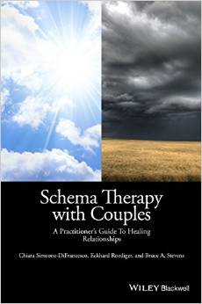
Books on schema therapy page 5
Simeone-DiFrancesco, C., Roediger E., and Stevens, B. (2015). Schema therapy with couples: A practitioner’s guide to healing relationships. Chichester: Wiley-Blackwell.
To be released in July 2015
An in depth presentation of the schema therapy approach to working with couples. An international collaboration between authors from the USA, Germany and Australia that draws on their own experiences as well as insights from discussions with an international online group of schema therapists pioneering the application of schema therapy to couples’ therapy.
See it at:
http://www.amazon.co.uk/Schema-Therapy-Couples-Practitioners-Relationships/dp/1118972678
Behary, W. (2013). Disarming the narcissist. Surviving and thriving with the self-absorbed (2nd ed). Oakland CA: New Harbinger.
New edition of a helpful book for therapists and clients who have to deal with narcissistic individuals. An excellent and accessible account of the schema therapy approach this kind of personality.
See it at:
http://www.amazon.co.uk/Disarming-Narcissist-Surviving-Thriving-Self-Absorbed/dp/1608827607

Slide 6
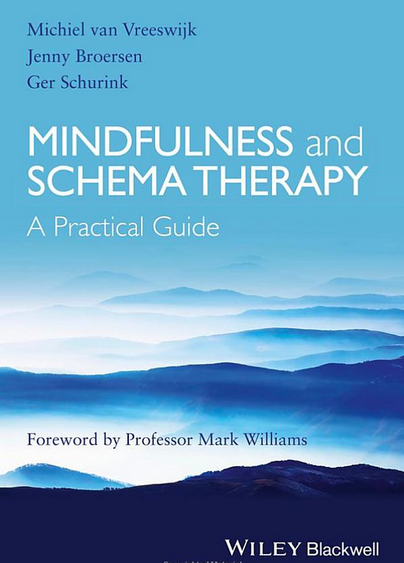
Books on schema therapy page 6
Van Vrieswijk,M., Broersen, J., Schurink,G. (2014). Mindfulness and Schema Therapy: A Practical Guide.
Provides a basic guide to the steps of mindfulness practice and how the practice can help with the identification of schema modes and therapeutic work with them.
See it at: http://www.amazon.co.uk/gp/product/1118753178
Bennett-Goleman, T. (2001). Emotional alchemy: How your mind can heal your heart. London: Rider.
A self help book that incorporates concepts from schema therapy and mindfulness meditation
See it at: http://www.amazon.co.uk/Emotional-Alchemy-Your-Mind-Heart/dp/1844130452

Slide 7
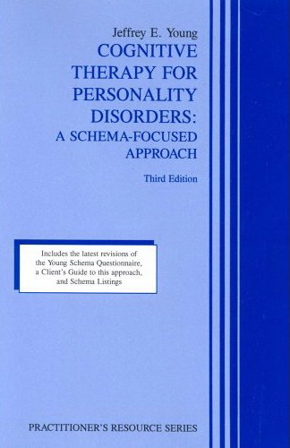
Books on schema therapy page 7
Young, J. E. (1999). Cognitive therapy for personality disorders: A schema-focused approach. (3rd ed.) Sarasota FL: Professional Resource Press.
Third edition of Young’s first book on schema therapy (first edition published in 1989). Still worth reading as the concepts are built round a very clear case study. Much of the material has been incorporated into Young, Klosko & Weishaar (2003).
See it at:
http://www.amazon.co.uk/Cognitive-Therapy-Personality-Disorders-Schema-Focused/dp/1568870477

Slide 8
Books on schema therapy page 8
BOOKS IN GERMAN There is also a large number of other books in German (and Dutch). Here are some examples:
Loose, C., Graaf, P., & Zarbock, G. (2013). Schematherapie mit Kindern und Jugendlichen. Basel: Beltz.
Christof Loose and colleagues’ influential book on schema therapy for children and adolescents. The English translation is on its way and eagerly awaited!
See it at:
http://www.amazon.co.uk/Schematherapie-Kindern-Jugendlichen-Christof-Loose/dp/3621280146/
Zarbock, G. (2014). Einladung zur Schematherapie: Grundlagen, Konzepte, Anwendung. Basel: Beltz.
A book that focuses on how to develop as a schema therapist.
See it at:
http://www.amazon.co.uk/Einladung-zur-Schematherapie-Grundlagen-Anwendung/dp/3621281347/
This well established manual is already into its second edition.
Roediger, E, (2011). Praxis der Schematherapie: Lehrbuch zu Grundlagen, Modell und Anwendung (2nd edition). Schattauer Gmbh.
See it at:
http://www.amazon.co.uk/Praxis-Schematherapie-Lehrbuch-Grundlagen-Anwendung/dp/3794527674

